Slide 1

Big Data Analytics Technologies
Mapreduce vs spark
-Dilanka Wickramasinghe-
Notes:
Hello everyone,
Today I'm going to talk about two of the most popular big data analytics technologies - MapReduce and Apache Spark. As we all know, data is becoming more and more valuable in today's digital age, and the ability to effectively manage and analyze large amounts of data has become a critical skill for individuals and organizations alike.
In this presentation, I'll be providing an introduction to MapReduce and Apache Spark, two of the most widely used technologies for processing and analyzing big data. I'll be showcasing the results of loading, processing, and applying queries to a selected dataset on air flight delays.
Moreover, I'll be comparing and contrasting MapReduce and Apache Spark based on two key parameters - 'ease of use' and 'fast process'. This will help us understand the key differences between the two technologies and determine which one might be better suited for different use cases.
So sit back, relax, and get ready to learn about MapReduce and Apache Spark, and how they can help you make the most of your big data analytics projects.

Slide 2





SOME FACTS ABOUT ME
BSc (Hons) in Electronic and Tele-Communication Engineering (1st), UoM
Minor in Entrepreneurship, UoM
Co-Founder of IXD Labs (PVT) LTD
MSc in Data Science and Artificial Intelligence (Reading), UoM
Notes:
Here are some facts about me. I'm Dilanka Wickramasinghe, and I hold a BSc (Hons) in Electronic and Tele-Communication Engineering from the University of Moratuwa with a Minor in Entrepreneurship.
I am also the co-founder of IXD Labs (PVT) LTD, a tech startup that specializes in developing innovative software solutions to enhance user experiences.
Currently, I am pursuing an MSc in Data Science and Artificial Intelligence at the University of Moratuwa. This program has allowed me to expand my knowledge in the fields of data science and artificial intelligence.

Slide 3
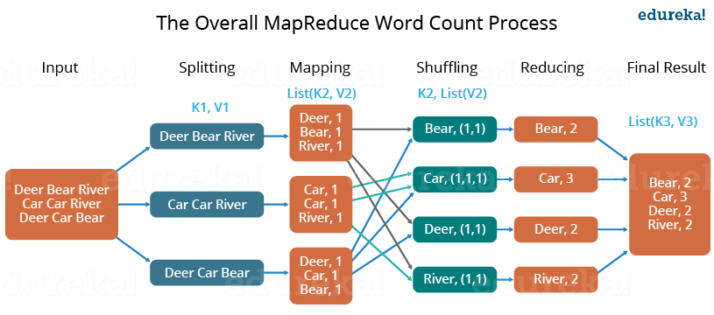


MapReduce
Introduced by Google in 2004.
Two main stages,
Map
Reduce
Highly scalable and fault-tolerant framework --> Ideal for processing large datasets
Notes:
MapReduce is a programming model and software framework used for processing large data sets in a distributed computing environment. It was introduced by Google in 2004 as a way to process vast amounts of data in parallel across large clusters of computers.
The MapReduce framework consists of two main stages: the map stage and the reduce stage. In the map stage, the input data is divided into smaller chunks and processed in parallel across multiple computers in a cluster. Each chunk of data is transformed into key-value pairs by applying a map function to the input data.
In the reduce stage, the output of the map stage is processed by a reduce function, which aggregates and summarizes the data based on the key-value pairs generated in the map stage. The results of the reduce stage are then combined to produce the final output of the MapReduce process.
MapReduce is a highly scalable and fault-tolerant framework, which makes it ideal for processing large datasets. It is widely used in the field of big data processing and is supported by a number of open source implementations, including Apache Hadoop and Apache Spark.

Slide 4




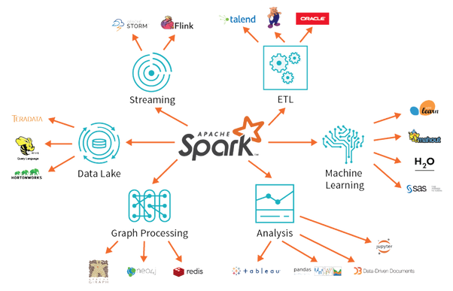




Apache spark
Apache Spark is an open-source, distributed computing system used for large-scale data processing.
Developed at the University of California, Berkeley and released as an Apache project in 2014.
Work with a variety of data sources,
Core data processing engine that supports in-memory processing --> Faster than traditional
Includes variety of modules for processing different types of data,
Structured Query Language (SQL)
Machine learning
Graph processing
Streaming
Uses a Resilient Distributed Dataset (RDD) as its primary data abstraction --> Fault-tolerance
Easy to use and developer-friendly APIs,
Notes:
Apache Spark is an open-source, distributed computing system used for large-scale data processing. It was developed at the University of California, Berkeley and released as an Apache project in 2014. Spark is designed to work with a variety of data sources, including Hadoop Distributed File System (HDFS), Apache Cassandra, Apache HBase, and Amazon S3.
Spark is built around a core data processing engine that supports in-memory processing, which makes it much faster than traditional data processing systems that rely on disk storage. It also includes a variety of modules for processing different types of data, including Structured Query Language (SQL), machine learning, graph processing, and streaming.
Spark uses a Resilient Distributed Dataset (RDD) as its primary data abstraction, which is a fault-tolerant collection of elements that can be processed in parallel across a cluster of computers. RDDs can be cached in memory to speed up iterative processing and are automatically recovered in the event of a node failure.
Spark is known for its ease of use and developer-friendly APIs, which include Java, Scala, Python, and R. It has become one of the most popular frameworks for big data processing and is widely used in industry and academia for a variety of applications, including data analytics, machine learning, and real-time stream processin

Slide 5
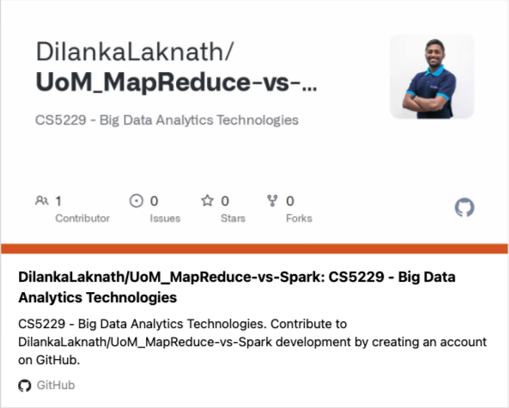

Results Demonstration
Notes:
Lets move to the Demo on loading, processing and applying queries to the selected dataset on airlines delayed flight dataset.

Slide 6
MapReduce Vs Apache Spark
 | Ease of Use | Fast Processing
MapReduce | MapReduce requires developers to write more code to implement data processing tasks, which can be time-consuming and error-prone. | MapReduce is slower than Apache Spark due to its reliance on disk storage for intermediate data. Each step of the MapReduce process involves writing data to disk, which can slow down processing times.
Apache Spark | Apache Spark provides a simpler, more developer-friendly API that makes it easier to write and debug code. | Apache Spark is faster than MapReduce due to its in-memory processing capabilities. Data can be cached in memory, which speeds up iterative processing tasks.
Notes:
Both MapReduce and Apache Spark are distributed computing frameworks used for processing large data sets, but they differ in terms of ease of use and speed.
Ease of Use:
MapReduce requires developers to write more code to implement data processing tasks, which can be time-consuming and error-prone.
Apache Spark provides a simpler, more developer-friendly API that makes it easier to write and debug code.
Fast Processing:
MapReduce is slower than Apache Spark due to its reliance on disk storage for intermediate data. Each step of the MapReduce process involves writing data to disk, which can slow down processing times.
Apache Spark is faster than MapReduce due to its in-memory processing capabilities. Data can be cached in memory, which speeds up iterative processing tasks.
In summary, Apache Spark is generally considered to be easier to use than MapReduce, thanks to its simpler APIs and interactive development environment. It is also faster than MapReduce due to its ability to process data in memory, making it more suitable for real-time data processing and iterative processing tasks.

Slide 7
Thank you!

